Slide 1
Partnership between licensing authorities and industry in implementing the Arms transfers controls : An Industry Perspective

Slide 2
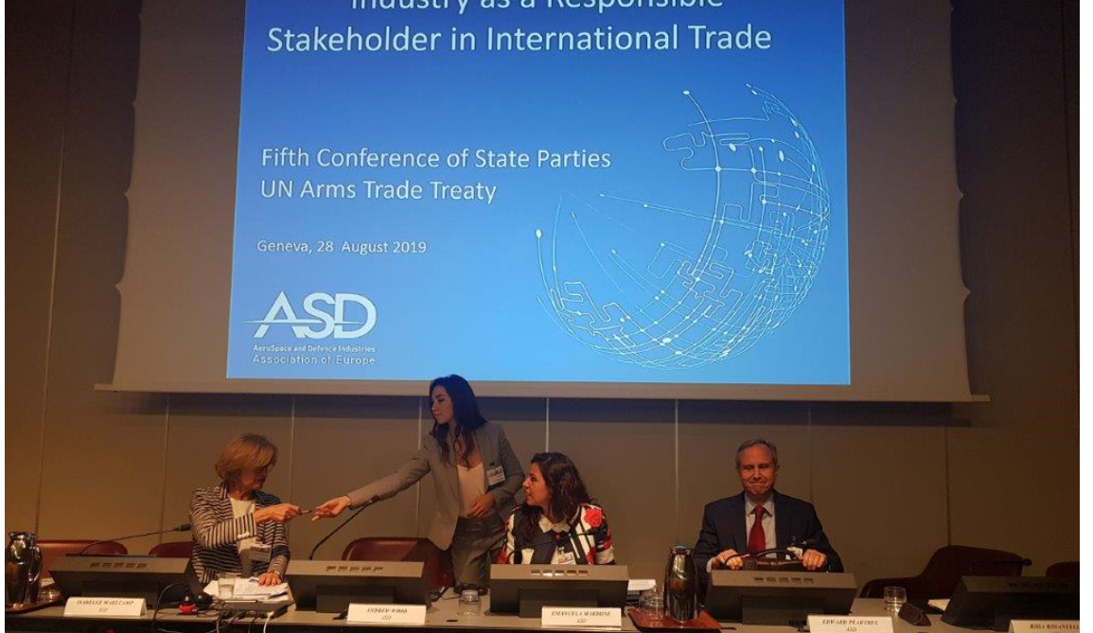
Role of Industry in ATT Process
Since the start of the UN ATT process, industry has been very involved in the development work.
The voluntary and active role of industry is recognised in the Preamble of the Treaty.

Slide 3
Effective Processes and ICPs
Industry's expertise can play an important role
Identify “red flags” and other risk indicators
Effective export controls processes and internal compliance programmes.
Uniquely able to reach out to its business partners and customers in other countries
Particularly those that are not States Parties to the Treaty.
This can benefit the objective of encouraging wider participation in the ATT

Slide 4
Industry Perspective and Drivers for Internal Compliance Programs

Slide 5
In practice: The importance of ICPs
Measures specifically aimed at preventing the illicit trade or diversion of conventional arms
A way to systematize the export control measures of a company
Structure a company’s best efforts to prevent violations from occurring via:
Standard operating procedures
Safeguards and
Personnel engagement

Slide 6
Current Challenges and Trends
New technologies and immaterial exports
Complex regulatory environment (extraterritorial regulations, continuous regulatory updates…)
Internationalization of the industry
Differences in implementation from country to country
Growing regulatory pressure
Negative image and press
Notes:
.

Slide 7
Industry Role in Implementing Arms Transfers Controls
States
Industries
Internal Compliance Program
Law
Regulation
A T T

Slide 8
Cooperation with Regulatory Authorities: Outreach and Proactive Exchanges
Government outreach to industry, open dialogue and communication is key.
Open dialogue
information on regulatory updates and “official interpretations”
best practices sharing
anticipate and mitigate export compliance-related risks
Improve understanding of regulations but also preferred approach of the authority
promote effective practices and more consistent standards
Notes:
.

Slide 9
A wide range of possibilities for outreach activities
Tools for outreach include:
Consultations/
Seminars/ Briefings/Workshops
Company visits
Websites and newsletters and “single windows”
Company visits are particularly effective tool
especially to reach out to SME
Allow witnessing the reality of an exporter, and its risks and challenges
beneficial for the authority and exporter alike because it reinforces mutual understanding and allows trust builfing
offers each a chance to ask questions that are relevant to the specific challenges of the exporters
Cooperation with industry associations
Notes:
These tools may

Slide 10
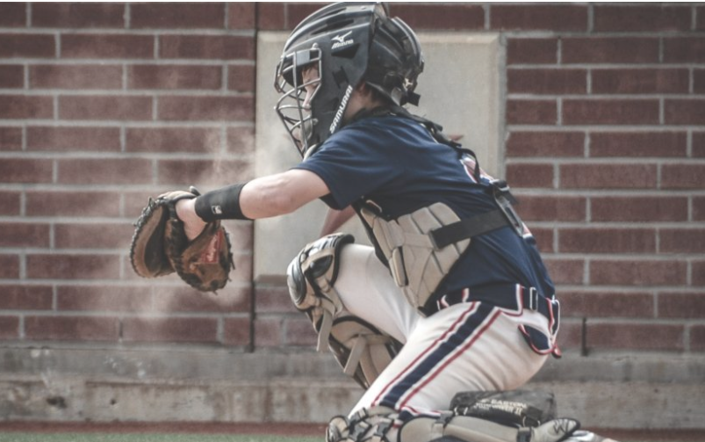
Industry not only as “catcher” but also as “pitcher”
Proactively cooperate with licensing authorities through professional associations or other exchange and discussion formats.
Contribute to a dialogue
Helps raise issues linked to implementation
Feedback on practical outcomes and possible side effects and interpretations
Bottom up understanding of economic impact/effects on competition.

Slide 11
Industry as catalyser of Outreach?
Industry is keen on looking at other similar operators and competitorsv. prescriptions from authorities may be perceived as too ”theoretical” / far from operational challenges.
Factual examples and pragmatic information is more understandable language for peers, translate into practice with examples
Continued positive effects may result from the establishment of networks with or between companies for better sharing of experiences.

Slide 12
The “Ideal World” Cooperation with Industry
In the „ideal world“, licensing authorities:
Have a hands-on practical understanding of industry and the different real-life scenarios
There is openness to meet, understand and discuss without bias
Acknowledge that defence industries are not „by definition“ in contrast with human rights but do a lot to prevent any such issue
Understanding of the technological developments and how quickly traditional principles can be outdated
Strive to adapt to the timeliness of industry requirements, to different varied scenarios and can propose solutions
Are in „listening mode“ and open about their reasoning and their concerns, stimulating mutual exchange and understanding

Slide 13
Thank you for your attention!
rosa.rosanelli@patriagroup.com

