Slide 1
Arms Transfers: Diversion risk and management
EU ATT OP II
Expertise France Devin Morrow
VTC
23 November 2020

Slide 2
Conflict Armament Research A NEW APPROACH TO WEAPON TRACING
Established in 2011.
Global operations.
iTrace EU Council Decisions (2013, 2015, 2017, 2019).

Slide 3
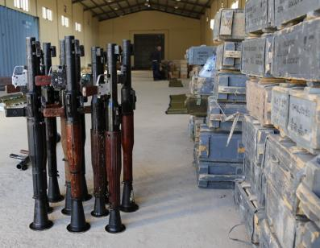
WHAT WE DO
Work with defense and security forces operating in conflict zones.
Identify and document illicit weapons and ammunition.
Provide verified evidence on patterns of weapon supply and procurement.

Slide 4
MISSION
Generate unique evidence on weapon supplies into armed conflicts to inform and support effective weapon management and control

Slide 5
DOCUMENTATION STATISTICS
600,000 weapons and ammunition documented.
500+ manufacturers in 60+ manufacturing states.
14,000+ unique chains of custody in 27 conflict-affected countries.
CAR has identified the specific point of diversion in 1,100+ cases.

Slide 6
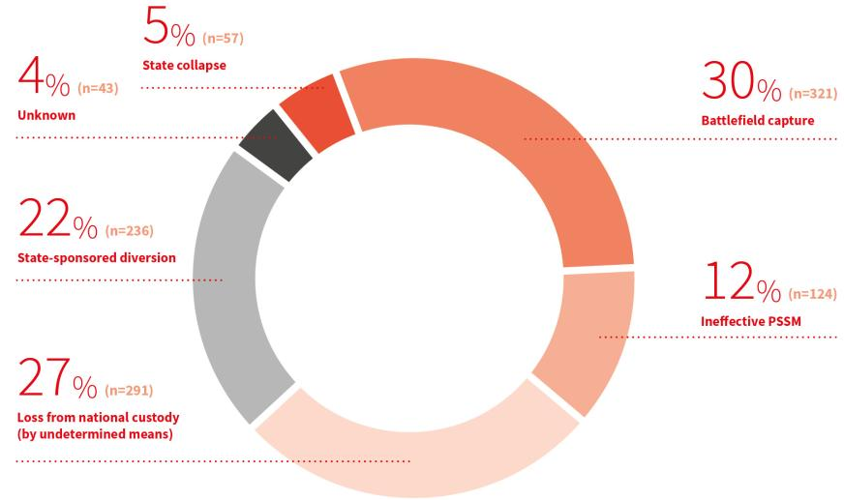
HOW DIVERSION OCCURS

Slide 7
INSUFFICIENT PSSM
Leakage due to ineffective physical security and stockpile management (PSSM).
Accidental or deliberate
124 cases of diversion from stockpiles (12%).
Typically small-scale leakage.
Type 56-2 assault rifle, documented in Nigeria in March 2018, that had been diverted from a neighbouring national stockpile.

Slide 8
DIVERSION FROM NATIONAL STOCKPILES
3718199
3715199
3728564
3712789
3716750
3717000
3717316
3718902
3719964
3722222
3726886
3728538
3728577
3728589
3731808
3717862
3718854
3725797
3728850
3829769
Notes:
.

Slide 9
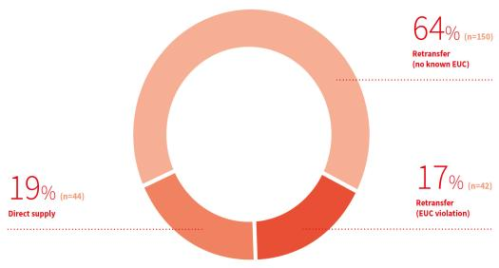
STATE-SPONSORED DIVERSION
236 cases of diversion backed by or linked to state actions (22%).
Direct supply from manufacturing country to end-users.
Retransfer in violation of end-user documentation.

Slide 10
UNAUTHORISED RETRANSFER
Export
12 December 2015
Diversion
Recovery
9 February 2015
Documentation
18 February 2015

Slide 11
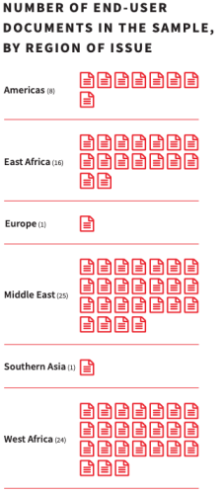
ANALYSING END-USER DOCUMENTATION
75 documents selected for analysis.
Fifteen importing countries, issued over a 20-year period.
Documents cover six of the eight ATT categories (primarily small arms and light weapons).

Slide 12
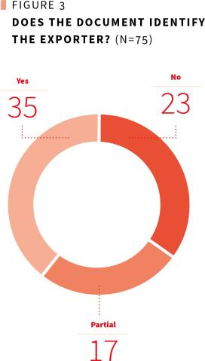
LACK OF STANDARDISATION
Documents often submitted on letterhead rather than official form templates.
Documents often lacking in detail.
Not always clear use of key terms.

Slide 13
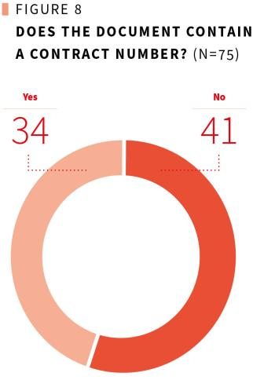
ABSENCE OF KEY INFORMATION
41 documents did not contain a contract number.
11 documents did not have an official stamp.
36 documents did not have a unique reference number.

Slide 14
INCONSISTENT RE-EXPORT CLAUSES
‘We will not re-export this item to any third party without the prior written authorization of the exporting authority.’

Slide 15
INCONSISTENT RE-EXPORT CLAUSES
CAR identified 19 different re-export commitments in 75 documents.
Re-sell, transfer, or transship
Re-sell or re-export
Sell or export
Sell or transfer
Sell, deliver, transfer
Sell, loan, re-export, transfer
Sell, loan, lease, re-export, transfer
Sell, transfer, re-export
Transfer by other means
Assign or export
Divert or export
Export for sale
Export or re-export
Re-export
Re-export or make available
Re-export or otherwise dispose
Re-export or transfer
Re-export, re-sell, or otherwise dispose
Re-export, re-sell, or otherwise transfer

Slide 16
POSSIBLE RED FLAGS
Patterns or inconsistencies in end-use practice that, if detected, might alert an export authority of a need to follow-up.
Identical reference numbers on different documents, issued to different export authorities over a five year period.

Slide 17
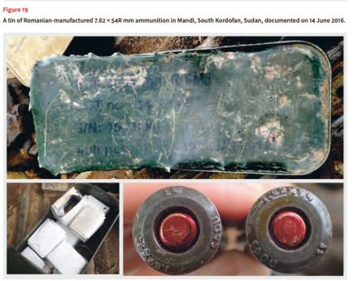
DURING TRANSFER
From: Weapon Supplies Into South Sudan’s Civil War. CAR, 2018.

Slide 18
LIMITED DELIVERY VERIFICATION
11 of 75 documents include a commitment to provide a DVC.
Need for DVC authentication.
No cases where a ‘Post-shipment verification’ clause was included.

Slide 19
RECOMMENDATIONS
Robust authentication of end-user documents.
Central, searchable registry of documents.
Strengthen and standardize re-export clause language.
Support end-use and diversion monitoring activities.
Develop a ‘delivery verification’ clause.
Treat any past violation of end-user assurances as a significant risk factor for future export considerations.

Slide 20
THANK YOU
CAR WEBSITE
www.conflictarm.com
iTRACE WEBSITE
www.itrace.com
EMAIL
morrow@conflictarm.com

