Slide 1
EU ATT-OP II – Thematic Webinars ATT annual reporting obligation Obligation, facts and figures, templates and instruments of assistance Tom Nijs Legal advisor, Flanders Department of Foreign Affairs, Belgium Co-chair ATT WGTR, 2018-2020

Slide 2
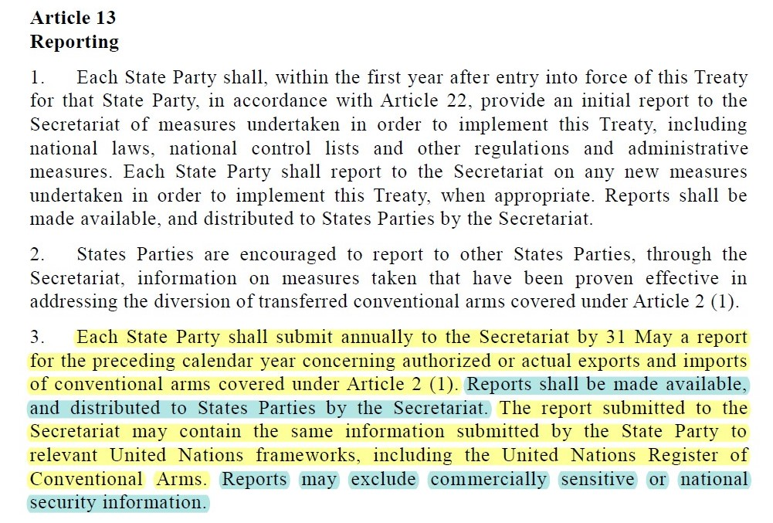
ATT annual reporting obligation
Arms Trade Treaty: article 13 (3) [Arabic, Chinese, French, Russian, Spanish]

Slide 3
Compliance with ATT annual reporting obligation?
ATT website: Reporting – Annual reports

Slide 4
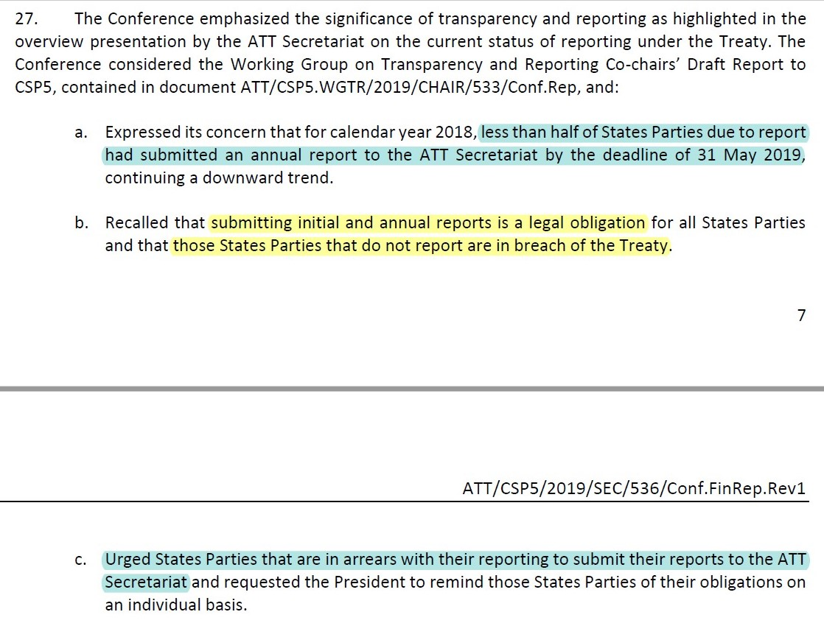
States Parties’ reactions to lack of compliance
Final report of CSP5

Slide 5
ATT Working Group on Transparency and Reporting (WGTR)
Working paper on the establishment on a WGTR
Subsidiary body of the Conference of States Parties to the ATT
Formally established at CSP2
Successor of informal working group on reporting (templates)
Annual mandate with specific tasks

Slide 6
ATT WGTR reporting assistance instruments
CSP1-CSP2: Voluntary reporting templates
CSP2: National-level Measures to Facilitate Compliance with Reporting
CSP3: Q&A-style guidance document on annual reporting obligation
CSP4: Outreach strategy on reporting
CSP5: Voluntary practical bilateral (and regional) assistance with reporting

Slide 7
Voluntary reporting templates
Facts
Initial Reporting Template and Annual Reporting Template
Endorsed and recommended for use at CSP2
Basis for online reporting tool
Under review since CSP5
CSP7 WGTR mandate: “Finalize review based on draft proposed amendments and comments in WGTR co-chairs’ report to CSP6”

Slide 8
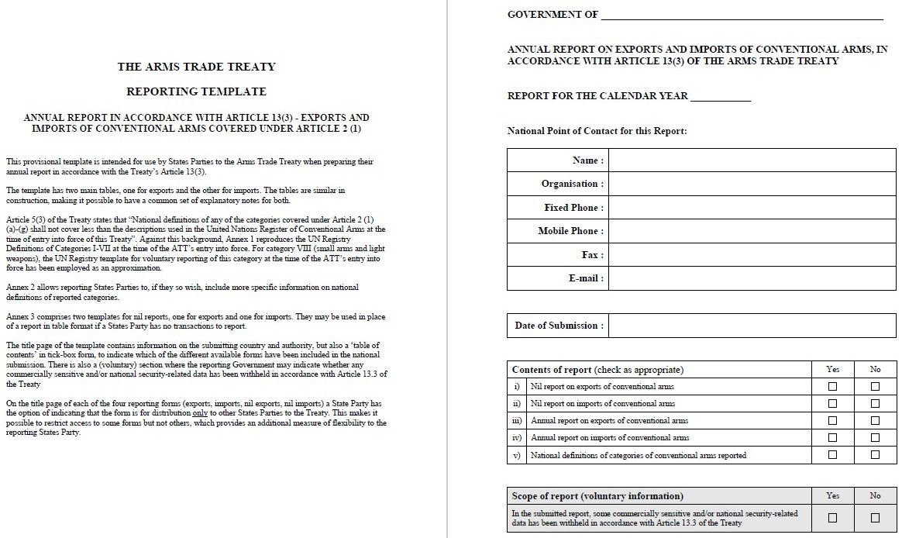
Voluntary reporting templates
Current Annual Reporting Template [Arabic, Chinese, French, Russian, Spanish]
See ATT website: Reporting – Reporting requirements
Annual Reporting Template after CSP7?
See Annex C of WGTR co-chairs’ report to CSP6

Slide 9
National-level measures to facilitate compliance with reporting
Facts
Useful measures for organizing reporting work:
Recommended for consideration at CSP3
“Menu of suggestions”: not binding
1. National procedures document | 4. Repository for data
2. List of contact points | 5. Training in collecting/compiling data
3. Coordinating entity | 6. Continuity

Slide 10
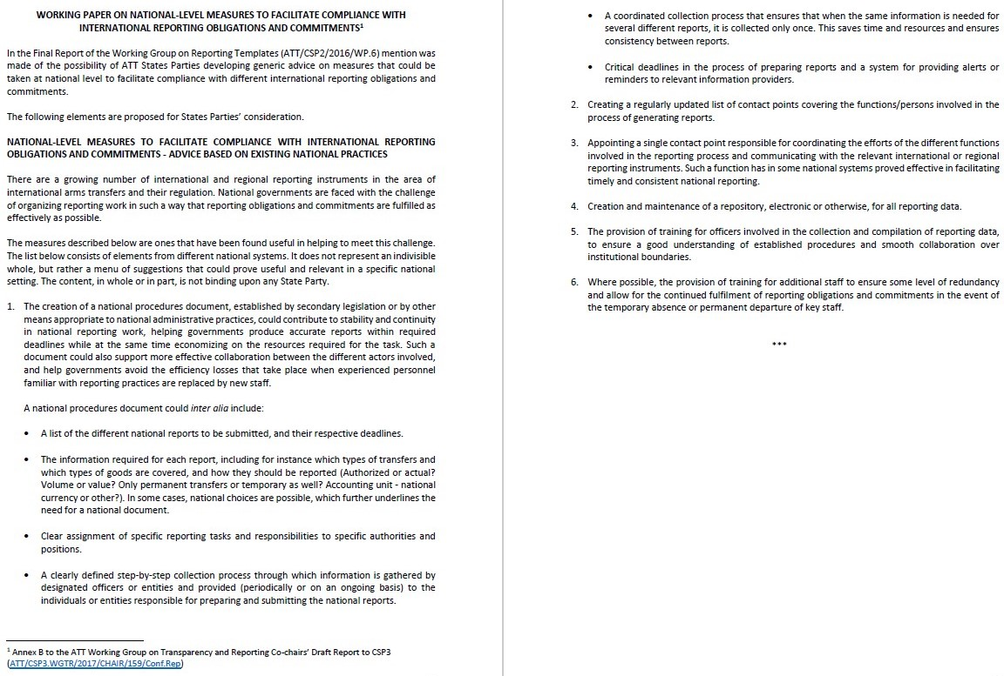
National-level measures to facilitate compliance with reporting
[Arabic, Chinese, French, Russian, Spanish]
See ATT website: Reporting – Reporting requirements

Slide 11
Q&A-style guidance document on annual reporting obligation
Facts
Comprehensive list of 46 questions and answers in six categories:
Endorsed as an “informative and open-ended reference document” at CSP3 (voluntary guidance)
Proposals for alterations and additional questions possible at any time (for discussion in WGTR)
Slightly amended at CSP5 to reflect introduction online reporting tool
A. Basic requirements | D. Form of the report and use of templates
B. Scope (transfers & arms) | E. Procedures and formalities
C. Information to be reported | F. Enforcement of reporting

Slide 12
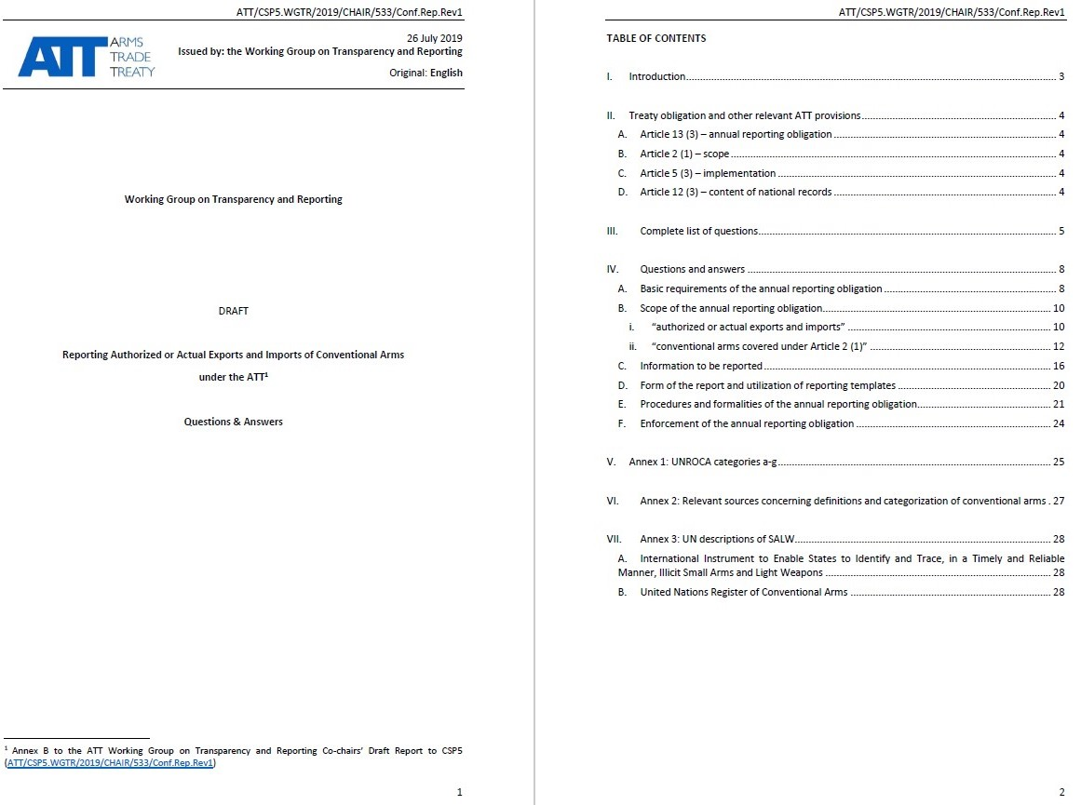
Q&A-style guidance document on annual reporting obligation
[Arabic, Chinese, French, Russian, Spanish]
See ATT website: Reporting – Reporting requirements

Slide 13
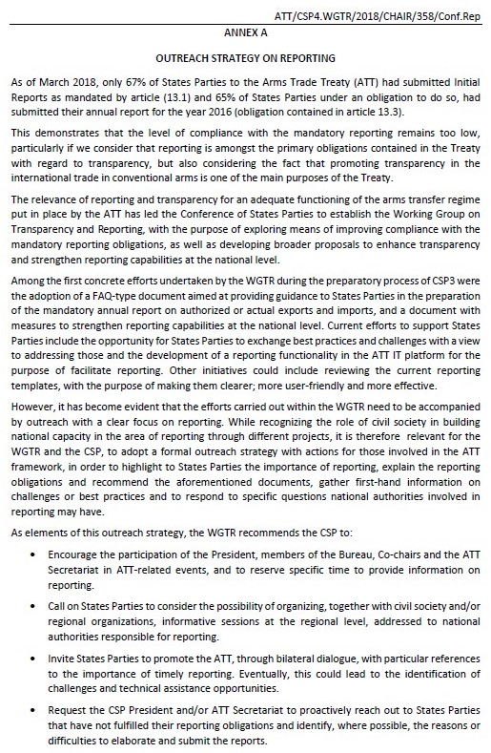
Outreach strategy on reporting
See Annex A of WGTR report to CSP4
Adopted at CSP4
Call to all stakeholders to inform about
reporting and promote compliance
Stakeholders report on implementation
in WGTR

Slide 14
Voluntary practical bilateral (and regional) assistance with reporting
Peer-to-peer exchanges under the auspices of the ATT Secretariat
Connecting reporters in need of assistance to experienced reporters
Kick-off at CSP5: ATT voluntary reporting assistance breakfast (“meet & greet”)
Monitoring of implementation in WGTR

Slide 15
Future assistance?
Enhanced role for CSP President and ATT Secretariat?
Outreach and/or monitoring of compliance?

Slide 16
Questions?
Tom Nijs
Strategic Goods Control Unit Flanders Department of Foreign Affairs Havenlaan 88 box 80 | 1000 Brussels (BELGIUM) Tel. +32 (0)499 542690
E-mail: tom.nijs@buza.vlaanderen
www.fdfa.be/csg

